Slide 2
CORE BUSINESS

Slide 3
CORE BUSINESS
We are a company focused on innovation. Our main objective is to implement an effective networking model, promoting the Quadruple Helix Model wich includes the presence of the Government, Academy, Industry and the Consultancy`s sector. This allows us to create a consistent framework and building high level business relationships.
BioBiz`s model is focusing on supporting the best practices in RD (Research & Development) using a networking model already applied in the European and U.S.A.`s countries.
We are a group of highly qualified professionals who can provide a top notch model which include a unique business model in Mexico and Latin America, our aim is to offer the:
Speed Networking's skills.
Connect business's opportunities in Mexico and Latin America.
Supporting research and development in the various industries that are most Innovative.
Sector Analysis.
Define and understand knowledge driven economy and "transferable skills”.

Slide 4
BUSINESS OBJECTIVES
We have a unique business models, we link transferable skills across companies, innovation agents, clusters and industrial parks.
We have productively engaged different business activities within each of the business actors which includes, legal, market, commercial and business consultants under one objective (B2B).
We provide UNIQUE spaces and opportunities for business networking and effective connection between:
Researchers / Academics
Investors
Businessmen
Public workers
Consultants in different specialties:
Legal, Investment Funds, Marketing, etc.

Slide 5
SPEED
NETWORKING

Slide 6
OUR EXPERTISE
Products which are not available in the market.
Products that are builded and ready to go.
Products Prototype.
Companies that are looking for “Customization“ and asjust their business strategies.
Researchers that are looking to create linkages with the Industry
Consultants that are facilitating their expertise in the business value chain and ready to close GAP in the businees cycle.

Slide 7
KNOWLEDGE NETWORKING
We offer new techniques and put together experts in each different business`s area and generate new business opportunities.
Our wokshops are prepared for the attendes to deliver a succesfull networking model.
Business Plans
Idea or product registration
Exclusive agreements for a specified period
Profitable Projects for companies

Slide 8
BUSINESS RELATIONSHIPS ESTABILISHED MORE THAN 10 YEARS

Slide 9
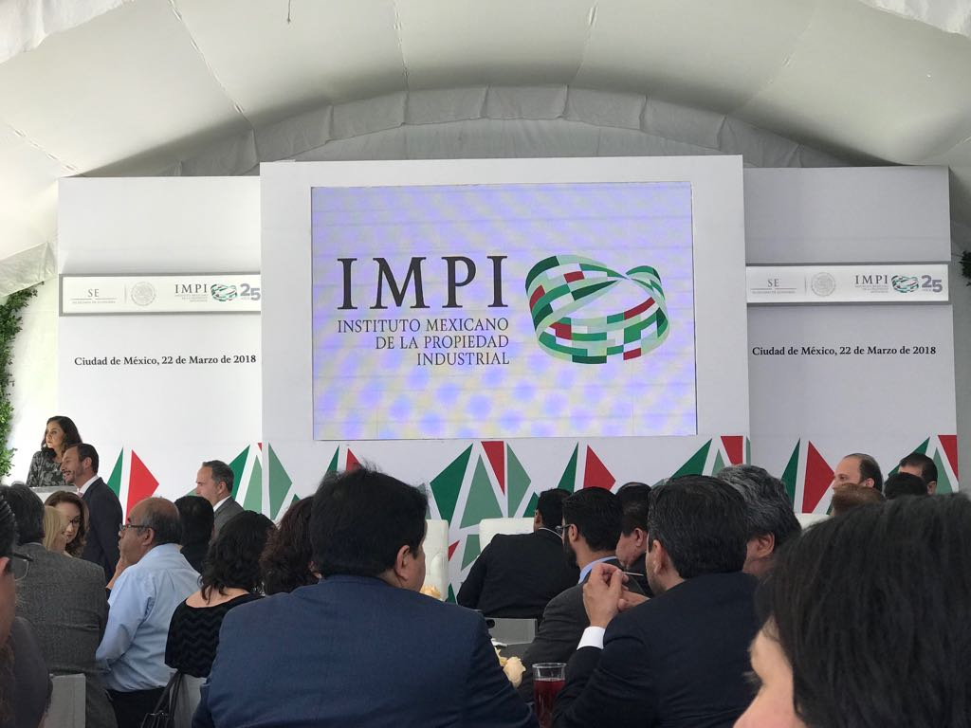
WELL ESTABILISHED RELATIONSHIPS ACCROSS …..
Without our business model, many others would struggle to find additional business opportunities..
We link with the Entrepreneurial Ecosystem:
CONACYT (RENIECYT)
IMPI
SECRETARIA DE ECONOMIA
INADEM
CAMARAS INDUSTRIALES
CLUSTERS DE SECTORES PRODUCTOS
CENTROS DE INVESTIGACIÓN
UNIVERSIDADES (UNAM, TEC DE MONTERREY, IPN, UAEM, IBERO, ETC.)

Slide 10
EXPERTISE ON INFLUENCE

Slide 11
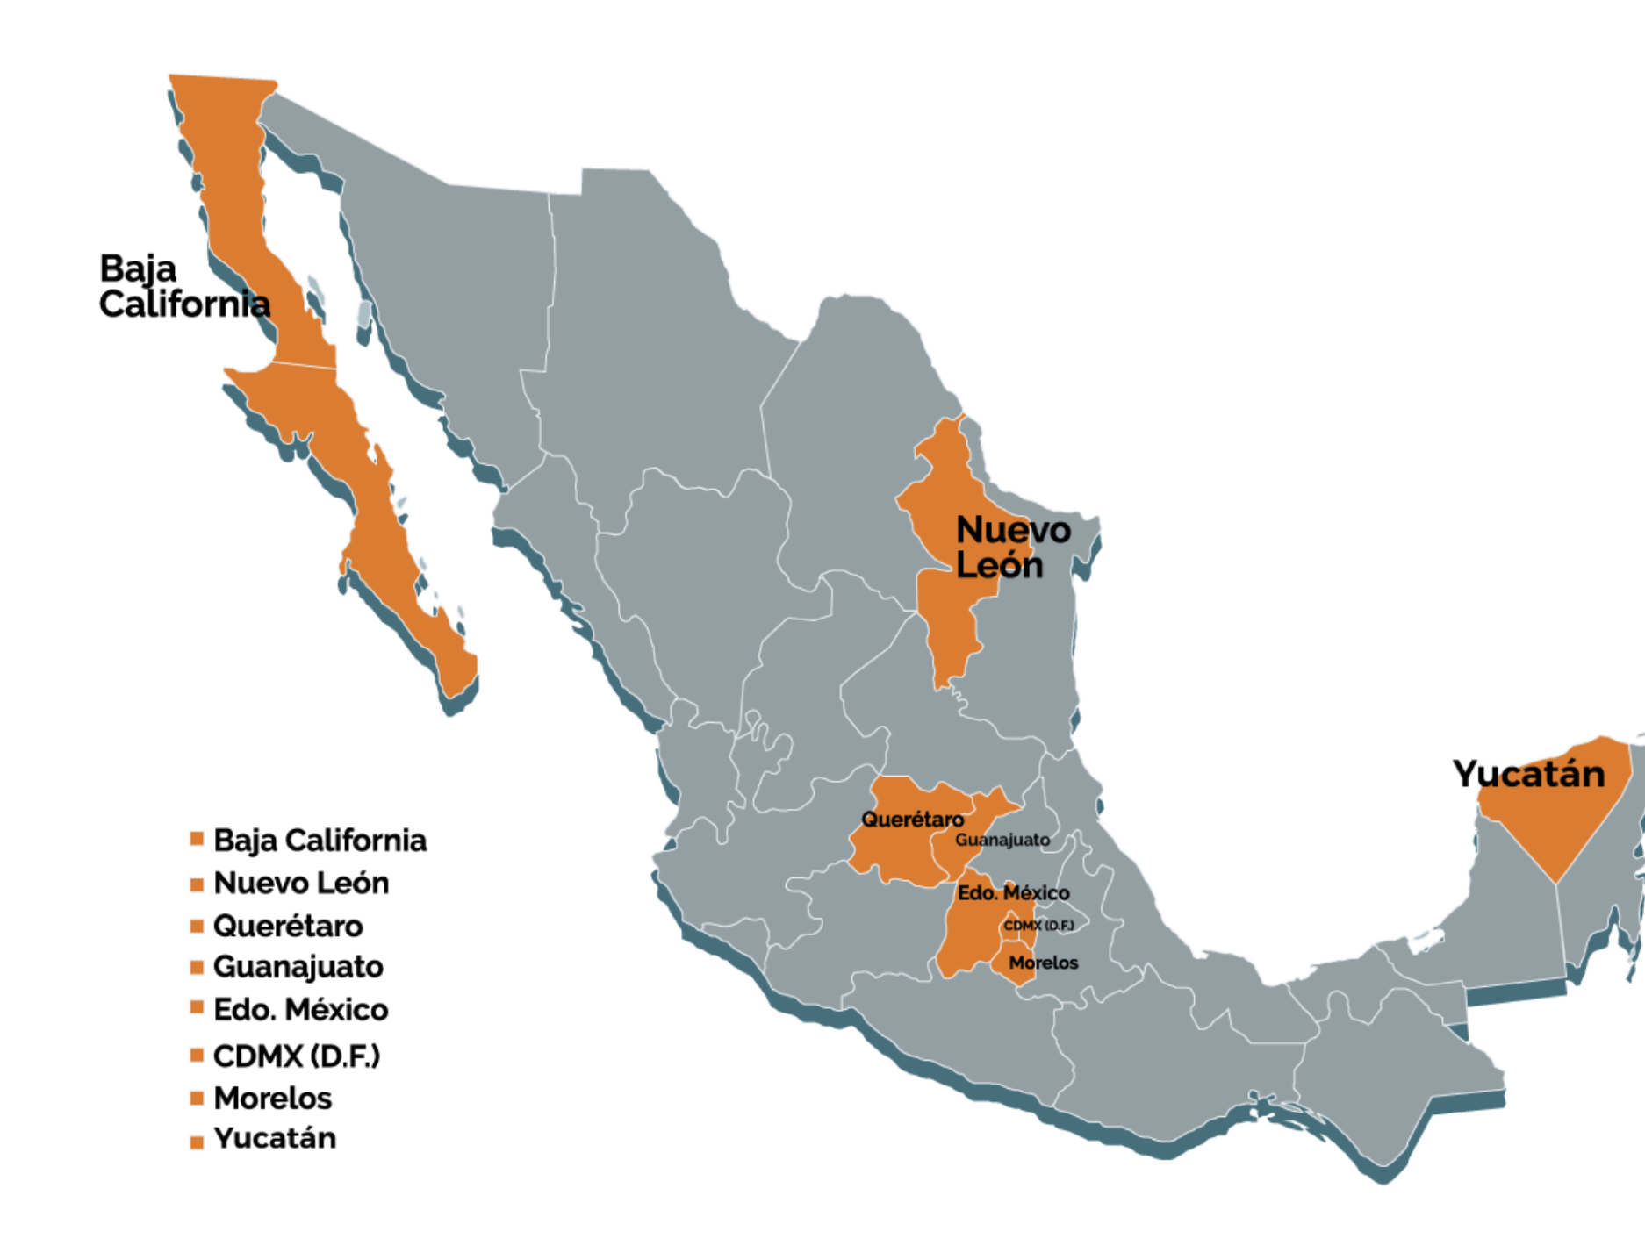
Our Business Path
From 2008 we have identified various regions in México that are prioritizing research innovation throughimportant linkages between Academy-Industry with great potential for innovation and business opportunities.

Slide 12
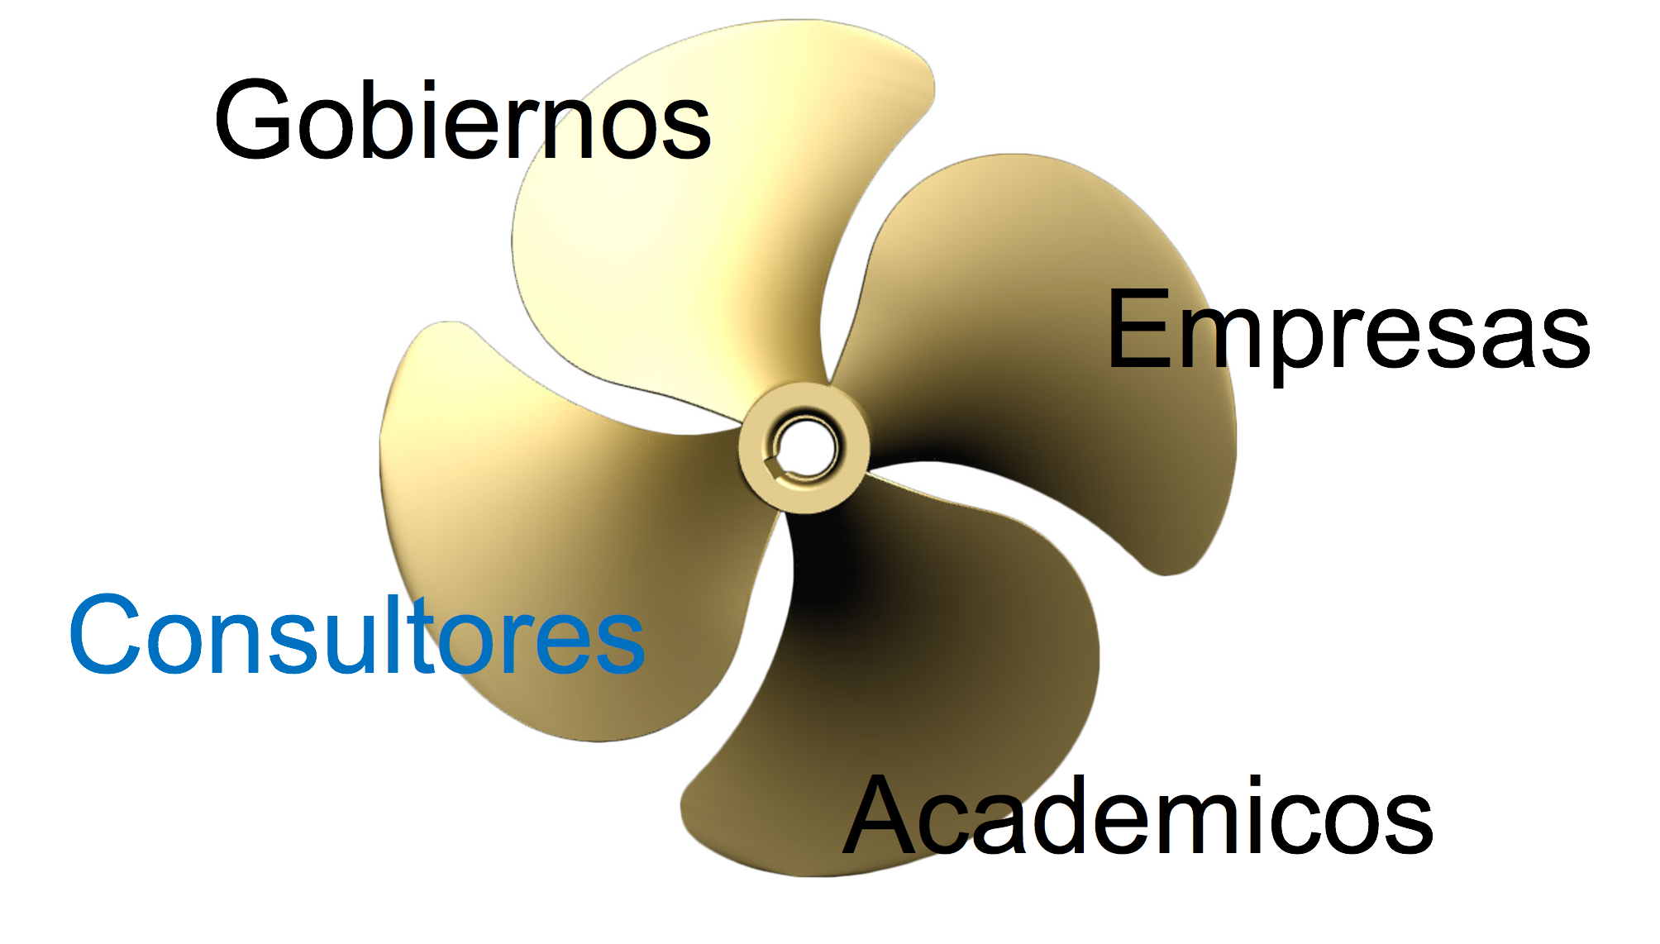
¿Biobiz?
Our work is fundamental to support the sinergy between the participants and strategic issues, continuosly promoting businesses, growing the portfolio clients with high level of competences and the interaction between them,such as entrepeneurs, center of researches, inventors.

Slide 13
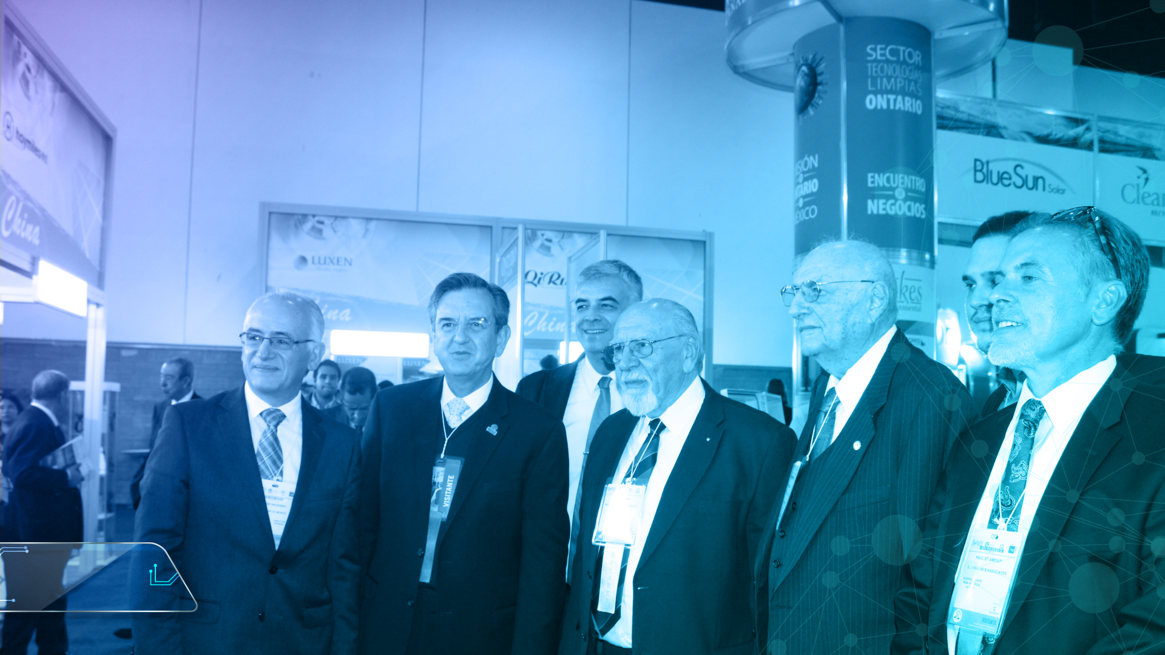
¿WHY E.J. KRAUSE TARSUS
OF MÉXICO?

Slide 14
ADDING VALUE…
We offer to contribute and add value to the existing E.J. Krause Tarsus Events model in México with:
Growing business and adding valued with top notch participants and additional activities in the event`s activities & programme.
Growing participation of the Local Government
Adding Academy`s expertise and offer showcase projects on a unique business model (clear added value to the existing events) link with local Research`s Centers.
Growing existing companies interest to E.J. Krause model, on a different approach.
A “Taylor Made” model, innovation at the core of event`s main strategy.

Slide 15
EJEMPLOS DE DESARROLLOS PARA EVENTOS ACTUALES
Contenido: POSTER para Branding

Slide 16
RECENT WORKING SAMPLES
Contenido: RRSS Y GIF para Branding

Slide 17
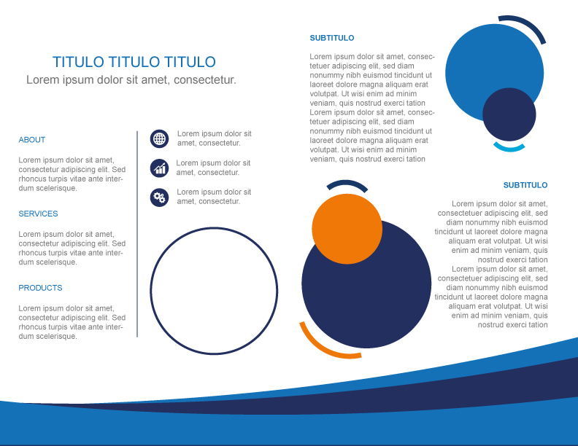
SOME OF OUR WORK SAMPLES
DÍPTICO

Slide 18
EJEMPLOS DE DESARROLLOS PARA EVENTOS ACTUALES
Contenido: Branding

Slide 19
GRACIAS

